Slide 1

FutureFocus: Wrap-up, Reminders, and FAQs
Thurs., Sept 17, 2026

Slide 2
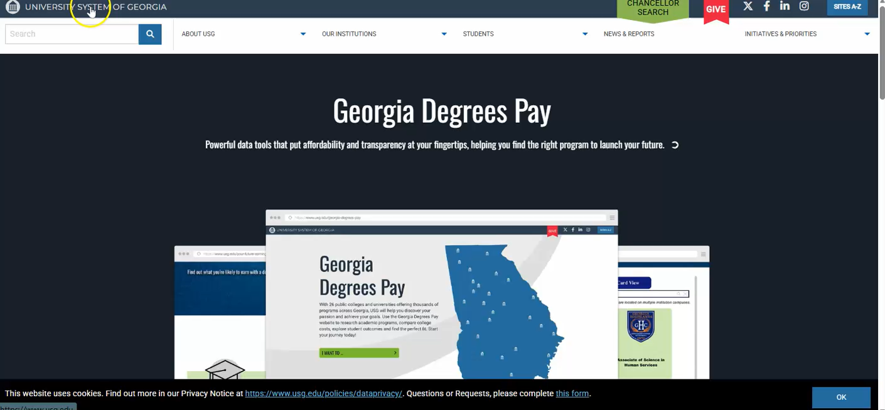
University System of Georgia website
The University System of Georgia (USG) has a great website to see the admission requirements of all the public 2- and 4-year colleges in Georgia.
Access the admission data here – https://www.usg.edu/student-affairs/prospective-students/freshman/

Slide 3
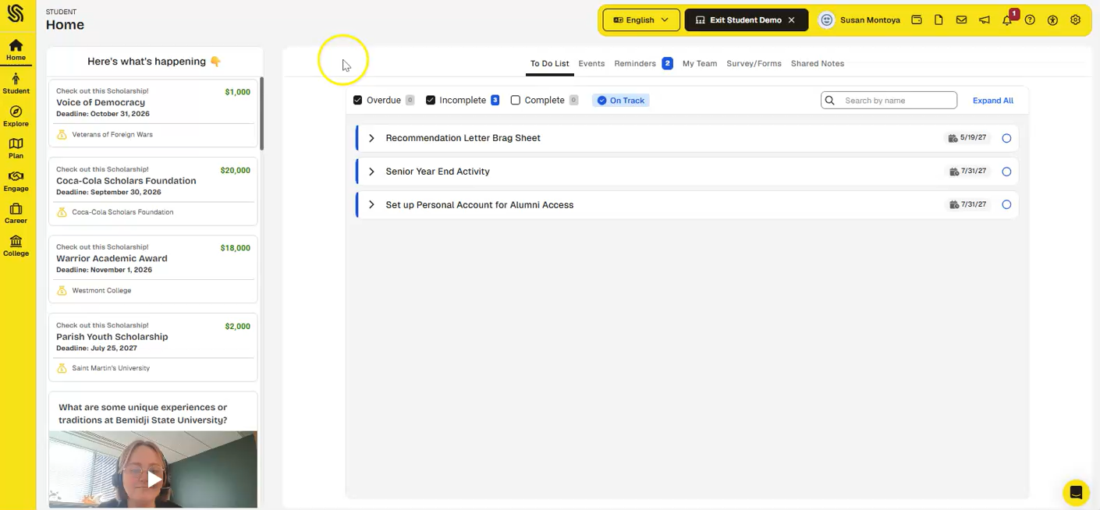
How to use Schoolinks to find good-fit colleges

Slide 4
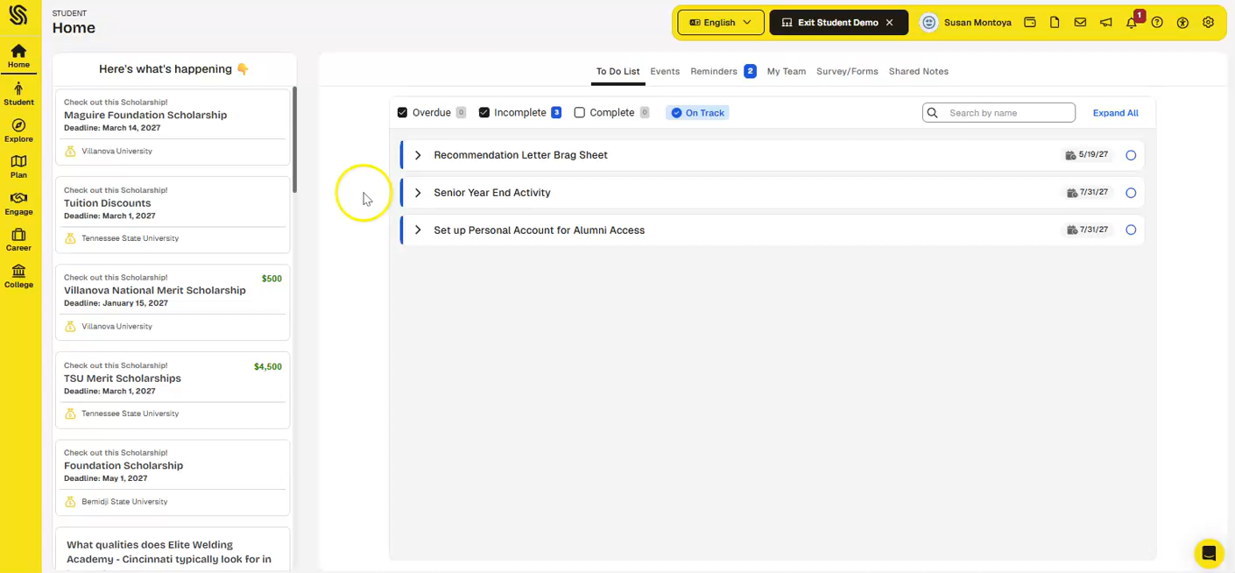
Requesting “outside” (Non-Pope) Teacher Recommendations

Slide 5
Step by Step list of Applying
Common App
Non-Common App
Create your Common App Account, add your colleges, and begin/complete your applications
Sign Common App FERPA waiver (Recommenders and FERPA)
Sign the SchooLinks FERPA waiver (College → College Applications)
Connect Common App and SchooLinks – this adds all colleges in Common App to SchooLinks and serves as your transcript request
Add teacher recommenders, if needed (talk to teachers first)
Request counselor recommendation in counseling office, if needed
Send test scores, if required, if you haven’t already
Complete everything by the application deadline
Create your application accounts on the college website/Coalition platform/Common Black Common App platform and begin/complete your applications/sign FERPA
Sign the SchooLinks FERPA waiver (College→College Applications)
Add your colleges individually to SchooLinks – this serves as your transcript request
Add teacher recommenders, if needed (talk to teachers first)
Request counselor recommendation in counseling office, if needed
Send test scores, if required, if you haven’t already
Complete everything by the application deadline

Slide 6
What are Pros/cons of Common App versus a “direct” application (or vice versa)?
Common App:
Saves time if you have several CA schools
Counselors must complete a School Report for every student before sending, so it can take a little longer for us to process information/materials
After the first app submission, Transcripts/Counselor Letters go automatically to colleges as you apply
Direct Applications:
If a college doesn’t require a lot of “extras” (like letters, essays, etc.), direct apps can sometimes be shorter and quicker
Transcripts may be sent a little quicker since the counselor doesn’t have to also fill out a school report
HOWEVER, each one has to be filled out individually and added in SchooLinks individually – that can take more time if you have a lot of apps

Slide 7
Common Info You May Need for Applications
Size of
Class of 2027 (approx.):
425
Class Rank Reporting
None
(CCSD does not rank)
Date of Entry
(aka 9th Grade Entry Date):
8/1/2023
Graduation Date: 5/19/2027
Ceremony Date is TBD
Grading Scale (if asked):
1-100
GPA Scale: 4.0
Report your “Cumulative Weighted GPA” unless instructed differently

Slide 8
Common Info You May Need for Applications
Course Levels
Regular/Standard or College Prep (just be consistent)
Honors/H
AP
Dual Enrollment
Schedule
Semester Schedule
Some are first semester/second semester
Grades are reported each semester:
Self-reporting of grades
Refer to your unofficial transcript (you have 2 copies!)
Copy courses/grades EXACTLY as you see them
Gov/Econ, Health/Pers Fit Psych/Soc
S1 (Fall) – “A” classes
We do NOT average the two for a “Final” grade so list every course and grade separately
Accel. Alg/Geom &/or Accel. Geom/Adv Alg
Most classes are full-year
S2 (Spring) – “B” classes
Most classes are 0.5 credit each semester

Slide 9
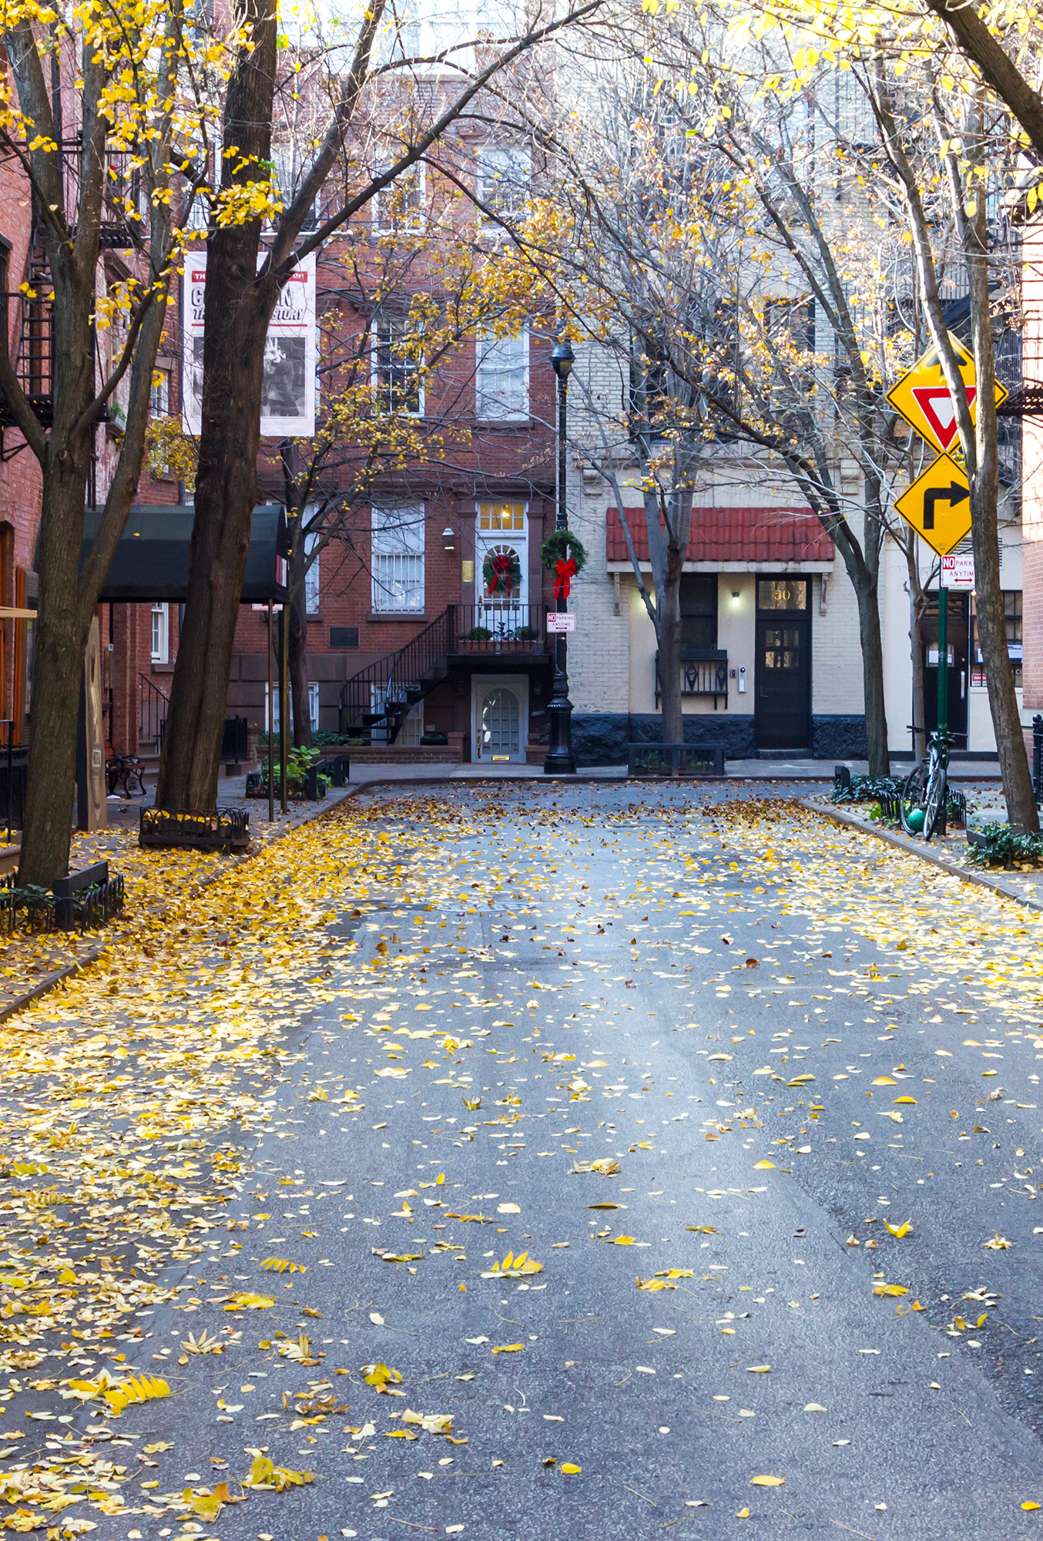

Differences Between Teacher and Counselor Recommendation Letters
Teacher Recommendation
Counselor Recommendation
“Google Street View”
Who you are day-to-day
Classroom specific behaviors/attitudes
Someone who can describe you well
May not be the class where you got the best grade! Maybe the class where you grew the most.
Preferably 11th or 12th grade and academic
Request in person at least a month prior to the application deadline (do not count breaks)
Put the request into SchooLinks
“Google Earth View”
Who you are from a broad context
Outside the classroom
Any “extras” you want us to share: “Distinctive Qualities,” “Academic Growth and Trends,” “Areas of Impact” “Extenuating Circumstances”
Request in person, in Counseling, at least two weeks prior to application deadline (do not count breaks)
Must have completed Student and Parent Brag Sheets, and provide a Resume

Slide 10
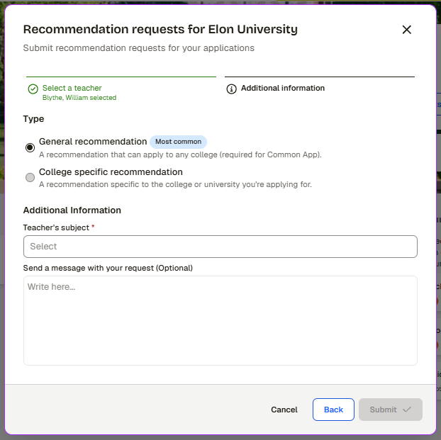
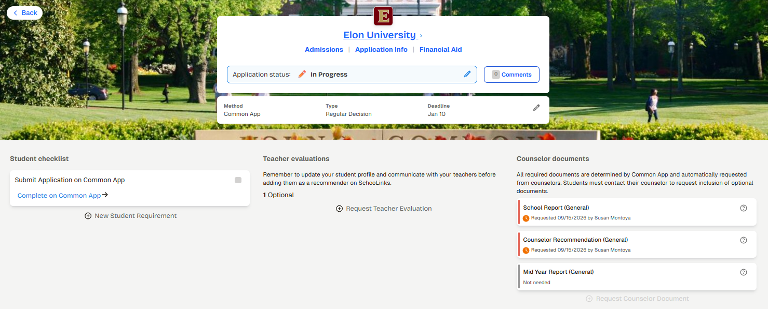
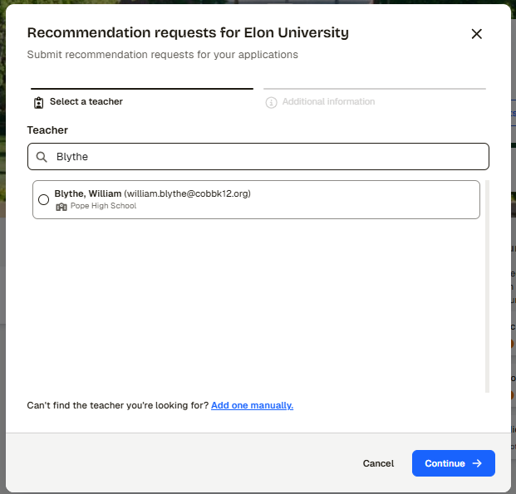
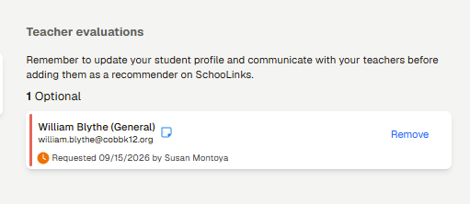
How to Request Teacher Evaluations (Recommendations)

Slide 11
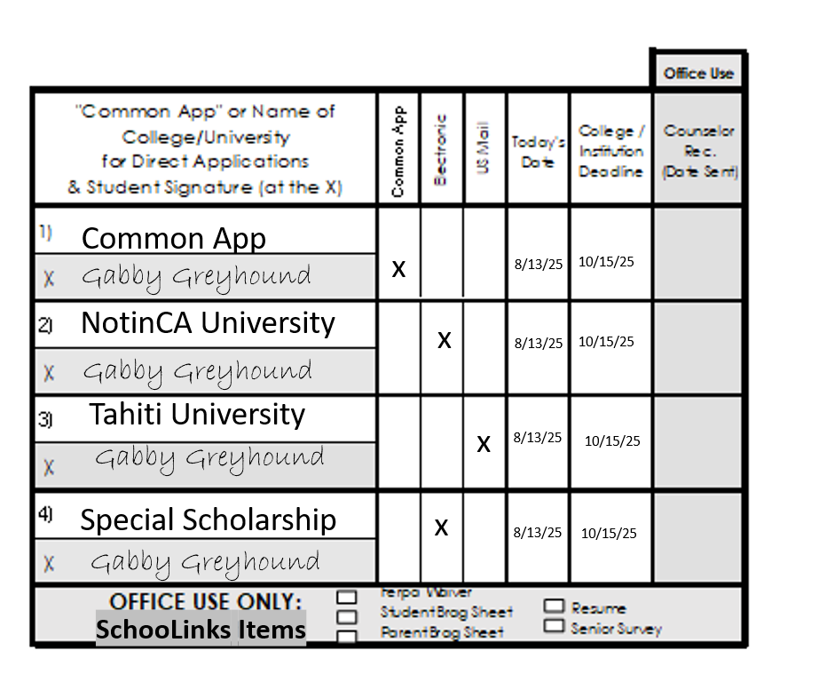
Counselor Letter of Recommendation
Card

Slide 12
How do I request my official transcript?
When you add a college into SchooLinks, you automatically request your transcript!
It shows up as “School Report” in SchooLinks under Counselor Documents
The School Report is made up of 3 things:
“School Report” cover sheet
A Pope School Profile
Your “Official Transcript”
Keep up with submission status of these documents in SchooLinks!

Slide 13
How to View Counselor Document Status
(School report, Counselor recommendation letter, Mid Year Report)

Slide 14
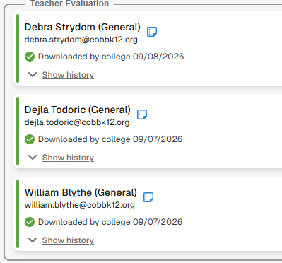
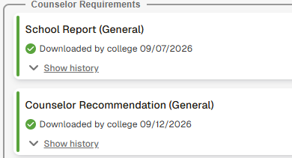
View Document Status in SchooLinks

Slide 15
What if I requested a LOR, but it hasn’t been sent yet?
Letters requested per our deadline requirements will be completed by the DOCUMENT/MATERIALS DEADLINES and in order received
If you wish to check in, with a recommender do so VERY POLITELY
  “Hi Mr./Mrs./Ms. – Hope you’re having a great semester! I wanted to check in on the status of my recommendation letter for XYZ college. The deadline is ABC, so just a few days away. Do you need anything from me to help you? I just want to make sure it’s still on your radar. Have a great day!”
We may need to prioritize requests submitted ahead of yours or those with earlier deadlines.
Colleges know letters take time to write
If there are special circumstances, or if a college is “rolling admissions,” discuss an appropriate deadline with the recommender.

Slide 16
Do I need to submit all applications and request transcripts all at once?
NO!!
Take your time with each application
Go ahead and submit each app when you complete each one

Slide 17
Should I wait for transcripts, letters, etc. to be submitted before sending my application?
NO – DO NOT WAIT!
Submit your application and the other pieces you’ve requested will be sent as they are completed.

Slide 18
Do I have to write an essay if it is not required?
Yes… No… It’s complicated…
Common App has a mandatory Writing section (250 words minimum) BUT for colleges that don’t require an essay, it will ask you at the end if you want to submit your essay or not.
You ALSO have unlimited essay edits for each CA submission, so you can adjust the essay before the next submission
Some colleges have essays marked as “optional” but may look at them for other purposes, such as scholarship or honors college consideration. (Kennesaw, for example). READ THE INFO FOR EACH COLLEGE TO KNOW FOR SURE!
Direct applications – colleges that don’t require an essay typically won’t even have a space to enter one, but if it’s optional, again, it’s your choice. Make an informed decision by understanding how the college might view the essay if you send it!

Slide 19
A college emailed me and said that they don’t have my transcript or letter of recs!!!
WHY HAVEN’T YOU SENT THEM?
Pause. Take a deep breath.
Check the status in SchooLinks – has it been sent and/or downloaded by the college?
There could be an overlap of materials received and the notice being sent out (this happens A LOT and freaks people out).
Materials simply may not be processed yet or updated in your portal
It can take several weeks for college staff to reconcile your materials with your file. IT IS NOT INSTANTANEOUS!

Slide 20
My parent needs to do their brag sheet for a Counselor LOR
Where is it?
You can also download it from the Counseling CTLS → Resources
It’s in their Parent SchooLinks account →Guardian To-dos →Complete Guardian Form →2026-2027 Parent Brag Sheet

Slide 21
My HOPE GPA isn’t showing on GAFutures.org or there’s an error message
Either your Social Security Number isn’t correct, (or you simply don’t have one)
OR:
There is something different between your account and the information that has been uploaded from the school.
Come see your counselor (or email us) and we can help figure out what is going on!

Slide 22
When is graduation?
We don’t yet know!
Last year, it was announced in November
As soon as we know, we will let you know!

Slide 23
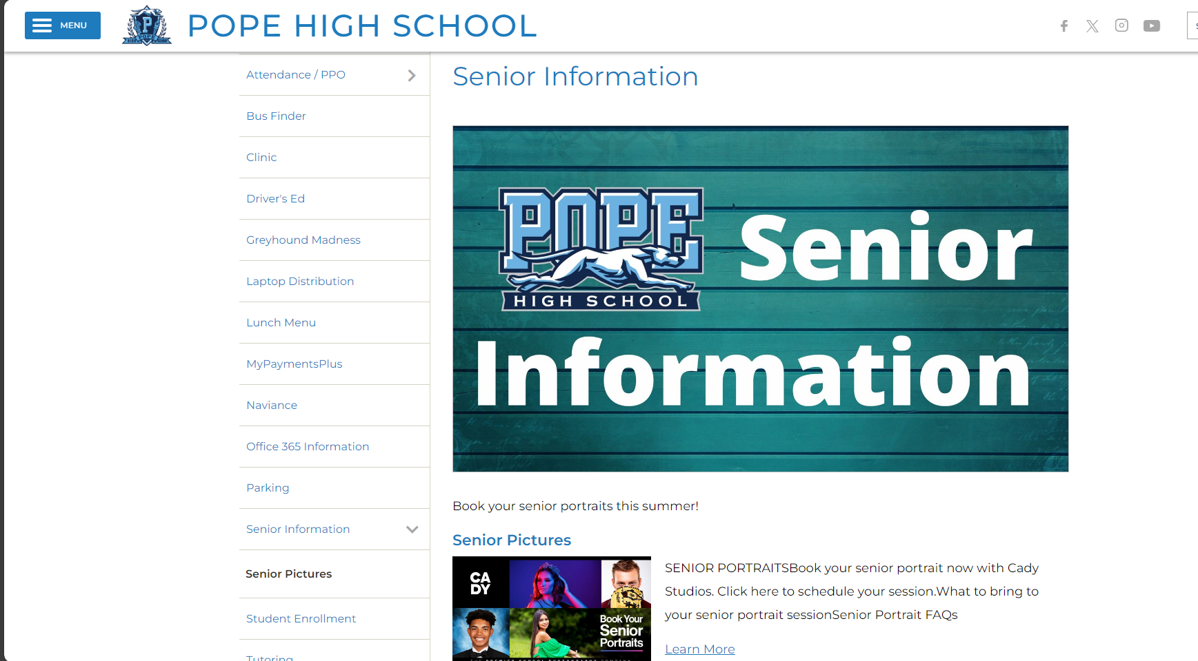
Where can I find Senior Information on the Pope Website?
Pope Menu → Resources → Senior Information

Slide 24
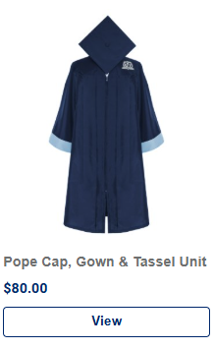
How do I order a cap & gown?
www.atlantagrad.com
$80 for Cap, Gown, & Tassel ONLY
(look in Individual Items, not Packages)
Other packages include additional items and are more expensive
AtlGrad will be here Sept 30 in Café for in-person orders!
Cap & Gown Delivery Day – March 11th, 2027 (at Pope)
Deadline Dec. 1
If you have a financial need, see your counselor!
Gowns are sized to fit (height/weight)

Slide 25

How and when do I have my senior portraits taken?
Book directly with Cady Studios
Sessions include your yearbook photo
Deadline is Saturday, October 31, 2026
More info on Pope Senior webpage

Slide 26
How do I manage everything and stay sane?
This is not a race!
Break steps into pieces
Mark all important dates on a master calendar
Don’t procrastinate – do at least one thing each week
Take/Review/explore career assessments
Connect with a military recruiter – we can help!
See your counselor if you are interested in a trade or apprenticeship for resources
“Undecided”
is the most popular major
Submit your applications!
If you feel lost, please let us help you! Make an appointment with your counselor.

Slide 27
Final Thoughts
You are ALL amazing
You ALL have incredible value
You are doing, and will continue to do, impactful things
You are all here to fulfill many purposes, even if you don’t know them yet
You CAN change your mind!
Everything ends up working out, even if you can’t see it now
You don’t have to do it alone
It’s ok to ask for help
We may not have all the answers or be able to move mountains, but… WE are here to support YOU in your journey.

Slide 28

Let us know how we can Focus YOUR Future!

